Slide 1
Java EE
COURSE OVERVIEW

Slide 2
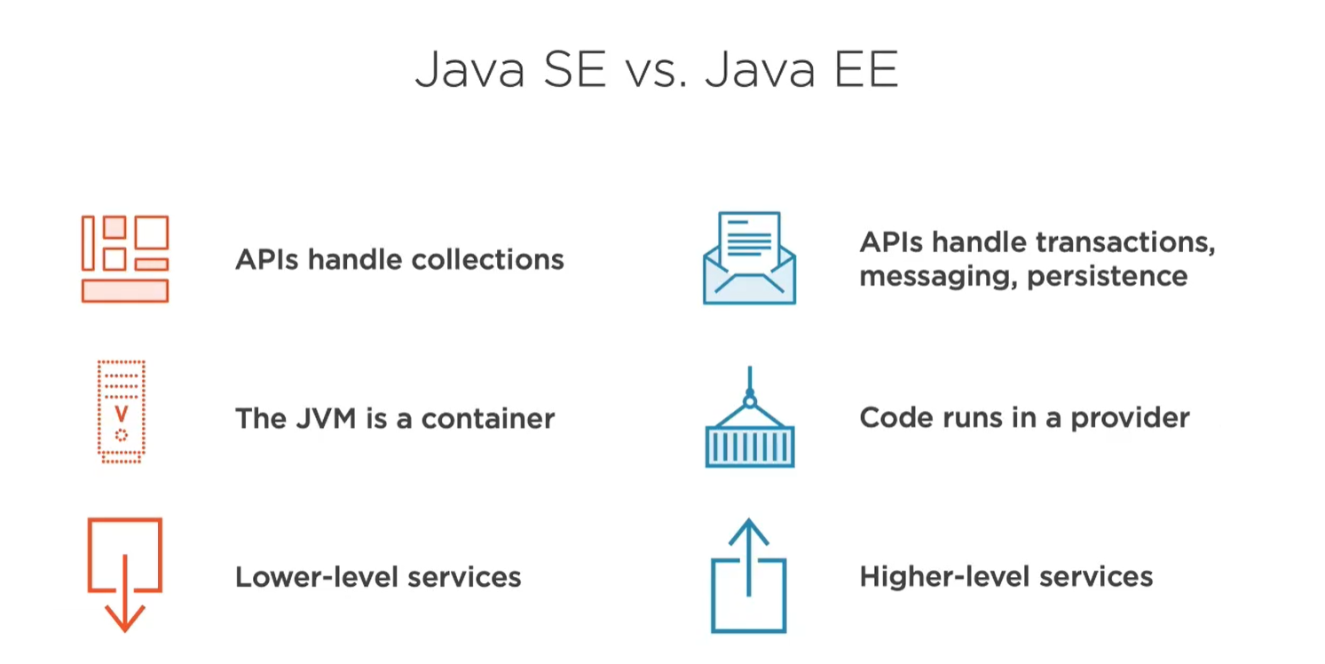
Course Outline

Slide 3
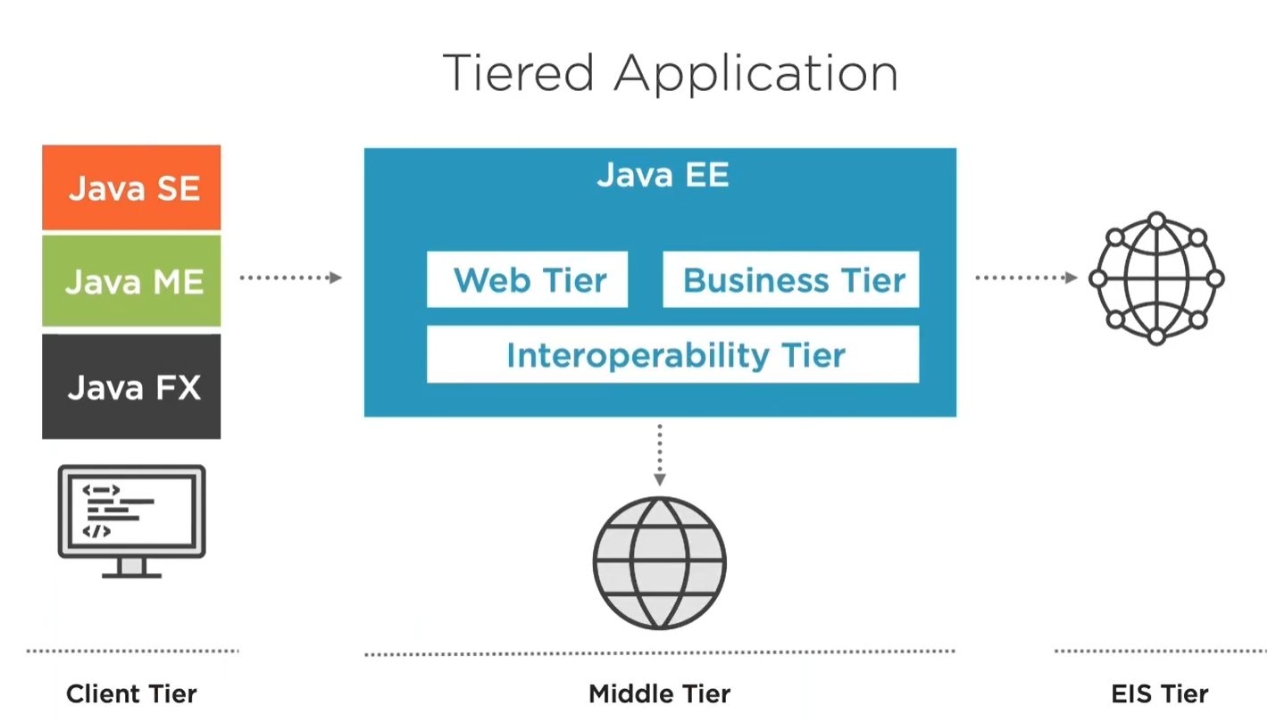

Slide 4
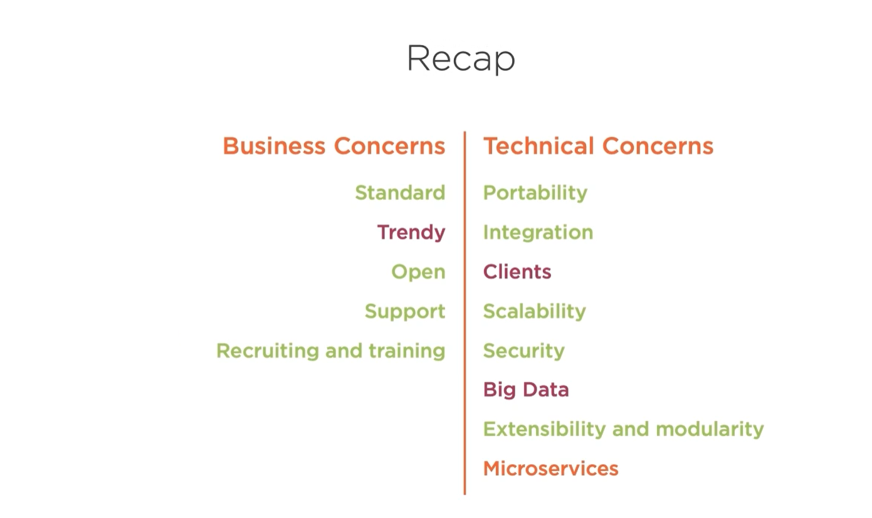

Slide 5


